Slide 1
Dictogloss
Good and evil from a Muslim point of view

Slide 2
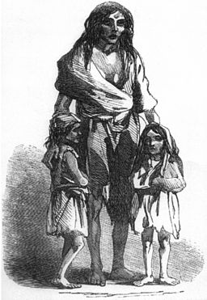
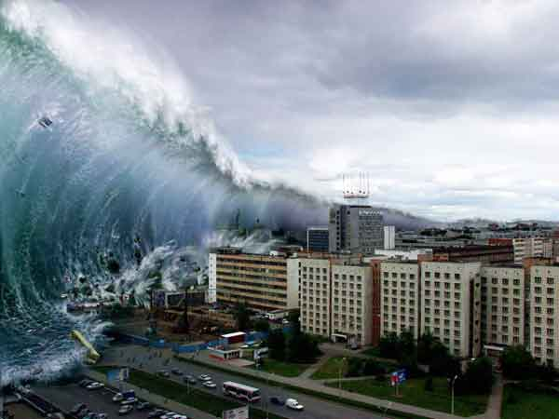
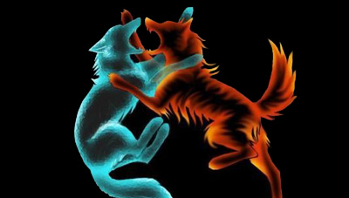
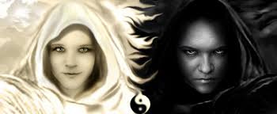
What do you see?

Slide 3
Listening activity
Listen to the passage being read to you.
You are going to recreate this passage in your own words.
Do not write anything while you are listening.
Now listen again.
This time you may make notes as you listen.

Slide 4
Listening activity
Work with your partner to improve your notes.
Now listen again for the last time.
You and your partner can still make notes as you listen.

Slide 5
Sharing activity
Get into a group with another pair.
Pool the notes that the four of you have made.
How can you improve your notes?
Consider:
use of key vocabulary
connectives for structure and direction
examples to back up your points

Slide 6
Writing activity
Now write your text.
You have 10 minutes.

Slide 7
There is no such thing as evil
Muslims explain the existence of evil in the world as a consequence of Allah banishing the angel Iblis from Heaven and cursing him that he would be punished on the Day of Judgement. Muslims believe that Iblis, or Shaytan tempts humans into making bad decisions which cause moral evil. However they see this the suffering they experience as a result of evil as Allah testing their faith. Suffering becomes an opportunity for humans to demonstrate that they truly believe in Allah.
Contrary to this, an atheist might argue that if Allah is omniscient, He would know how to stop evil and suffering. Furthermore, if He is omnipotent, He would have the power to prevent evil and suffering. Finally, if he were benevolent, He would love us enough to put a stop to all suffering and evil.
But Muslims view things differently. They believe that there is a reason why Allah allows suffering to persist; it is part of Allah’s greater purpose which is too complex for the human mind to understand. They believe that both natural evil and moral evil are part of Allah’s plan and therefore part of the test of human faith and human ability to resist the temptations of Shaytan. Allah gave humans free will so that they can learn from their mistakes and not be forced into a decision that is good or evil. If humans are tempted by Shaytan to do evil, they, like Shaytan, will be punished.
Atheists are likely to disagree completely that Allah is all knowing, powerful and loving. They contend that if he were, He would not allow suffering to carry on, even if it were part of a plan. If Allah is testing human faith, then why continue the test once an answer has been established? Also there is no proof or evidence that either Allah or Shaytan exist. Consequently, there is no explanation 4 evil or evidence that evil exists.
As an agnostic, I think the idea of Allah testing Muslims for them to prove their belief in His purpose cannot be well explained. The idea of humans having a conscience is understandable as is the extent to which one’s conscience might affect the way humans respond to temptation. However, in my opinion, the Muslim defence of evil and its purpose in the world is not justifiable.

